Slide 1
Apartments in the USA
Ali McCondichie, Kim Khue Nguyen, Leonardo Rodrigues Rodriguez, Seven George, Tyler Beringer

Slide 2

Objective
Analyze our data to find most important factors to customers when they are shopping for apartments.
We will attempt to answer the following questions:
Seasonal Trends
Regional Variations
Value
What is more important to renters - more bed/bath or more square feet?
Are there any trends in apartments prices throughout the year?
How do apartment prices vary by state and by city?

Slide 3
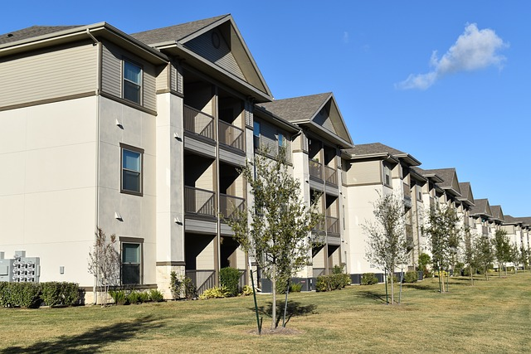
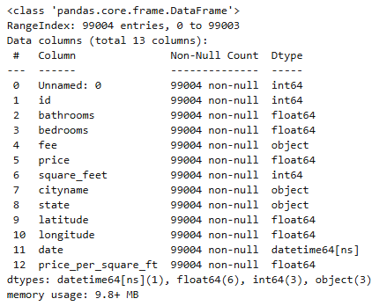
Our Dataset
10,000 apartment listing classifieds
Includes data such as price, bed/bath, location, etc.

Slide 4

Question 1:
Are there any trends in apartments prices throughout the year?

Slide 5

Feature Engineering:
Create a column to sort by seasons
Ability to see seasonal trends
Winter and Fall have the most data
Fall and Spring have the highest average rental price

Slide 6
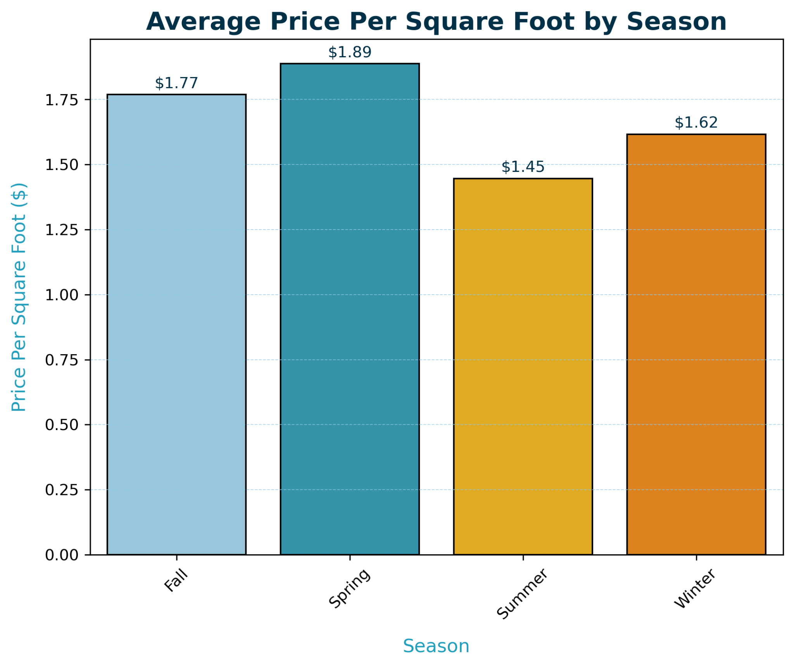
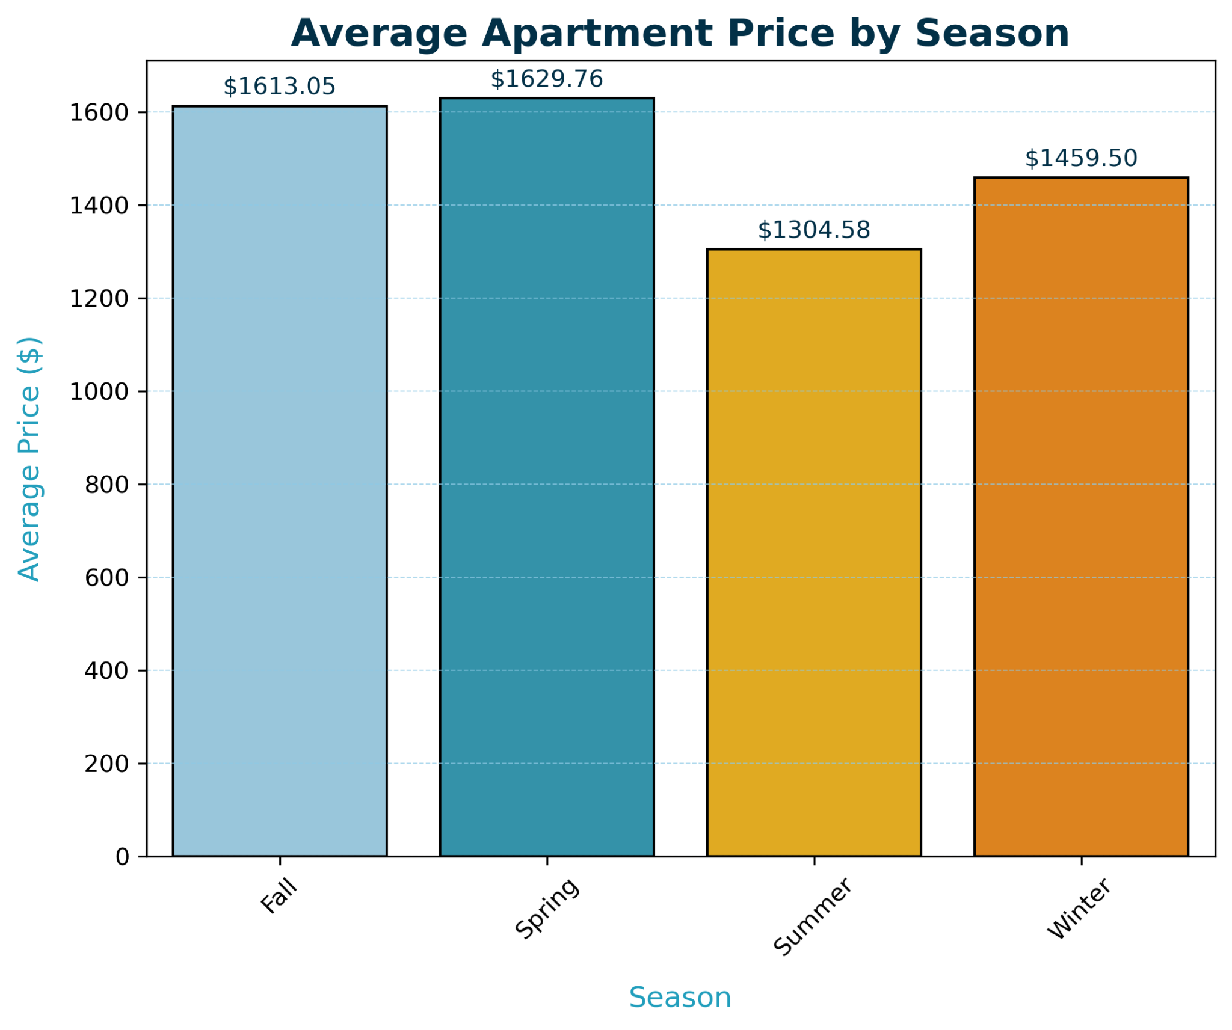
Seasonal Trends: Price per Square Foot vs Rental Price
Key Insights
Demand is HIGHEST in Spring and Fall
Best value for size is during Summer when demand is low
Notes:
Spring has the highest seasonal averages with $1.89 per square foot and $1629 monthly rent, and it also has the smallest number of listings in our dataset. So, that would suggest that the demand is highest in the spring when the vacancies or availabilities are lowest. To renters, avoiding apartment hunting during spring would be a smart move. Waiting until summer when the average prices are lowest with a little more availability to choose from would be ideal. Also, the price per square foot is at the lowest point of the year during summer so renters get the most value per square foot.

Slide 7
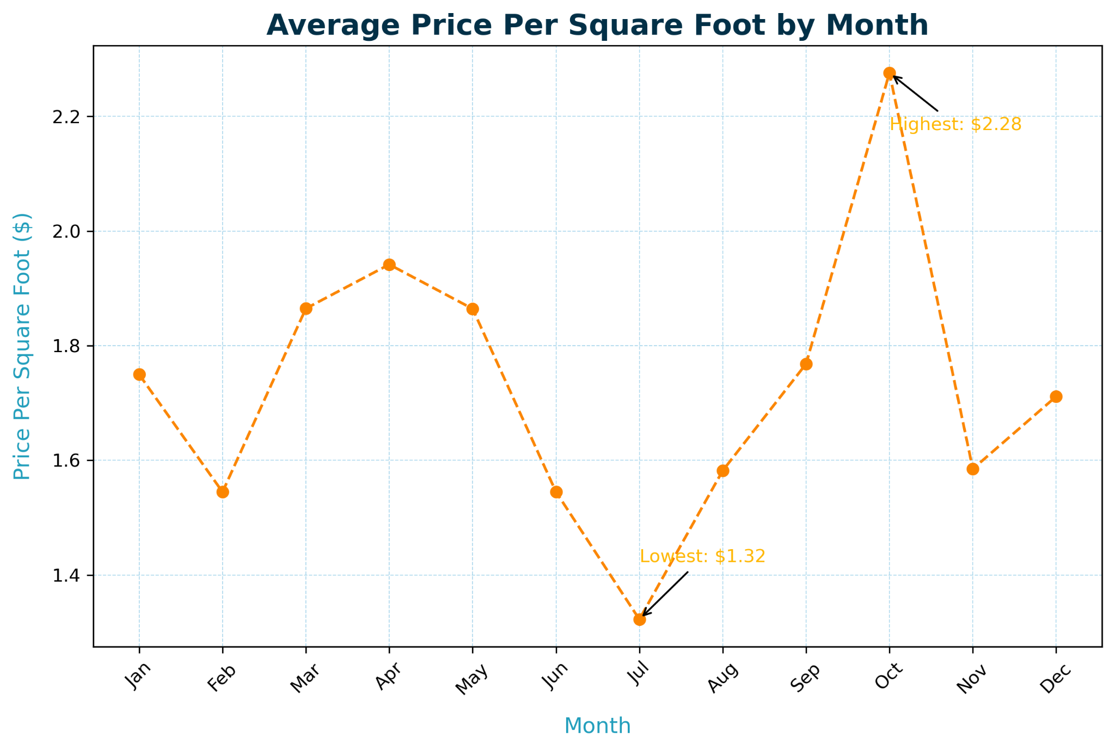
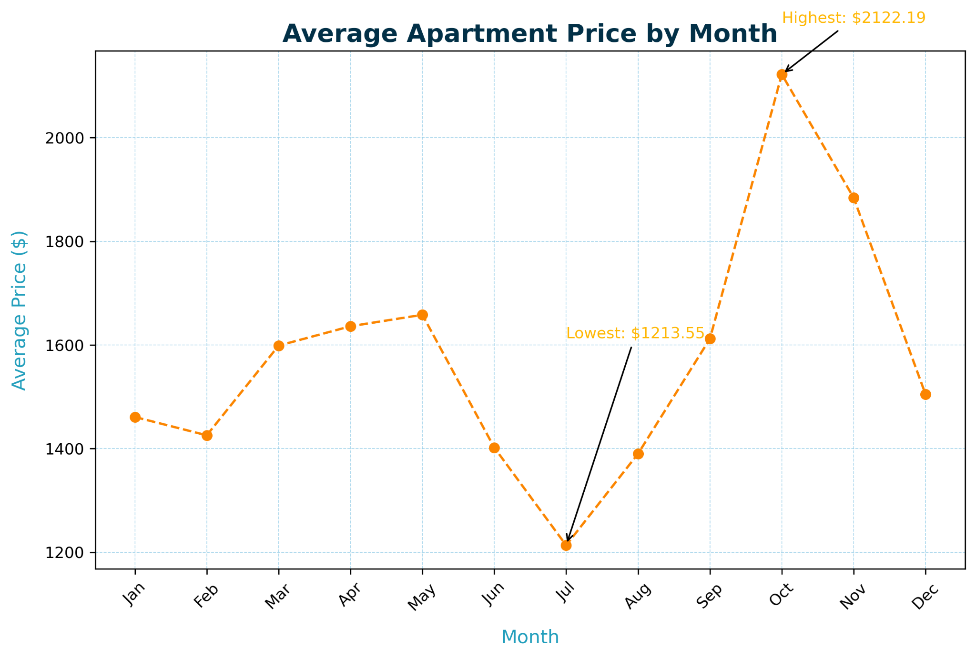
Monthly Trends: Price per Square Foot vs Rental Price
Key Insights
Demand is HIGHEST in October
Best value for size is in July when demand is low
Notes:
Now that we’ve seen what seasonal averages look like, we can look at monthly averages to narrow down even further which specific months have the highest and lowest averages. Even though spring was the most expensive season throughout the year with the least availability, October is actually the most expensive in terms of price per square foot and average rental price by far! Fall has quite a bit of availability with over 43,000 listings in our dataset in contrast to summer, which is less than 1,000 listings. In summer, the month of July holds the least expensive averages prices for both square foot and rental price.

Slide 8
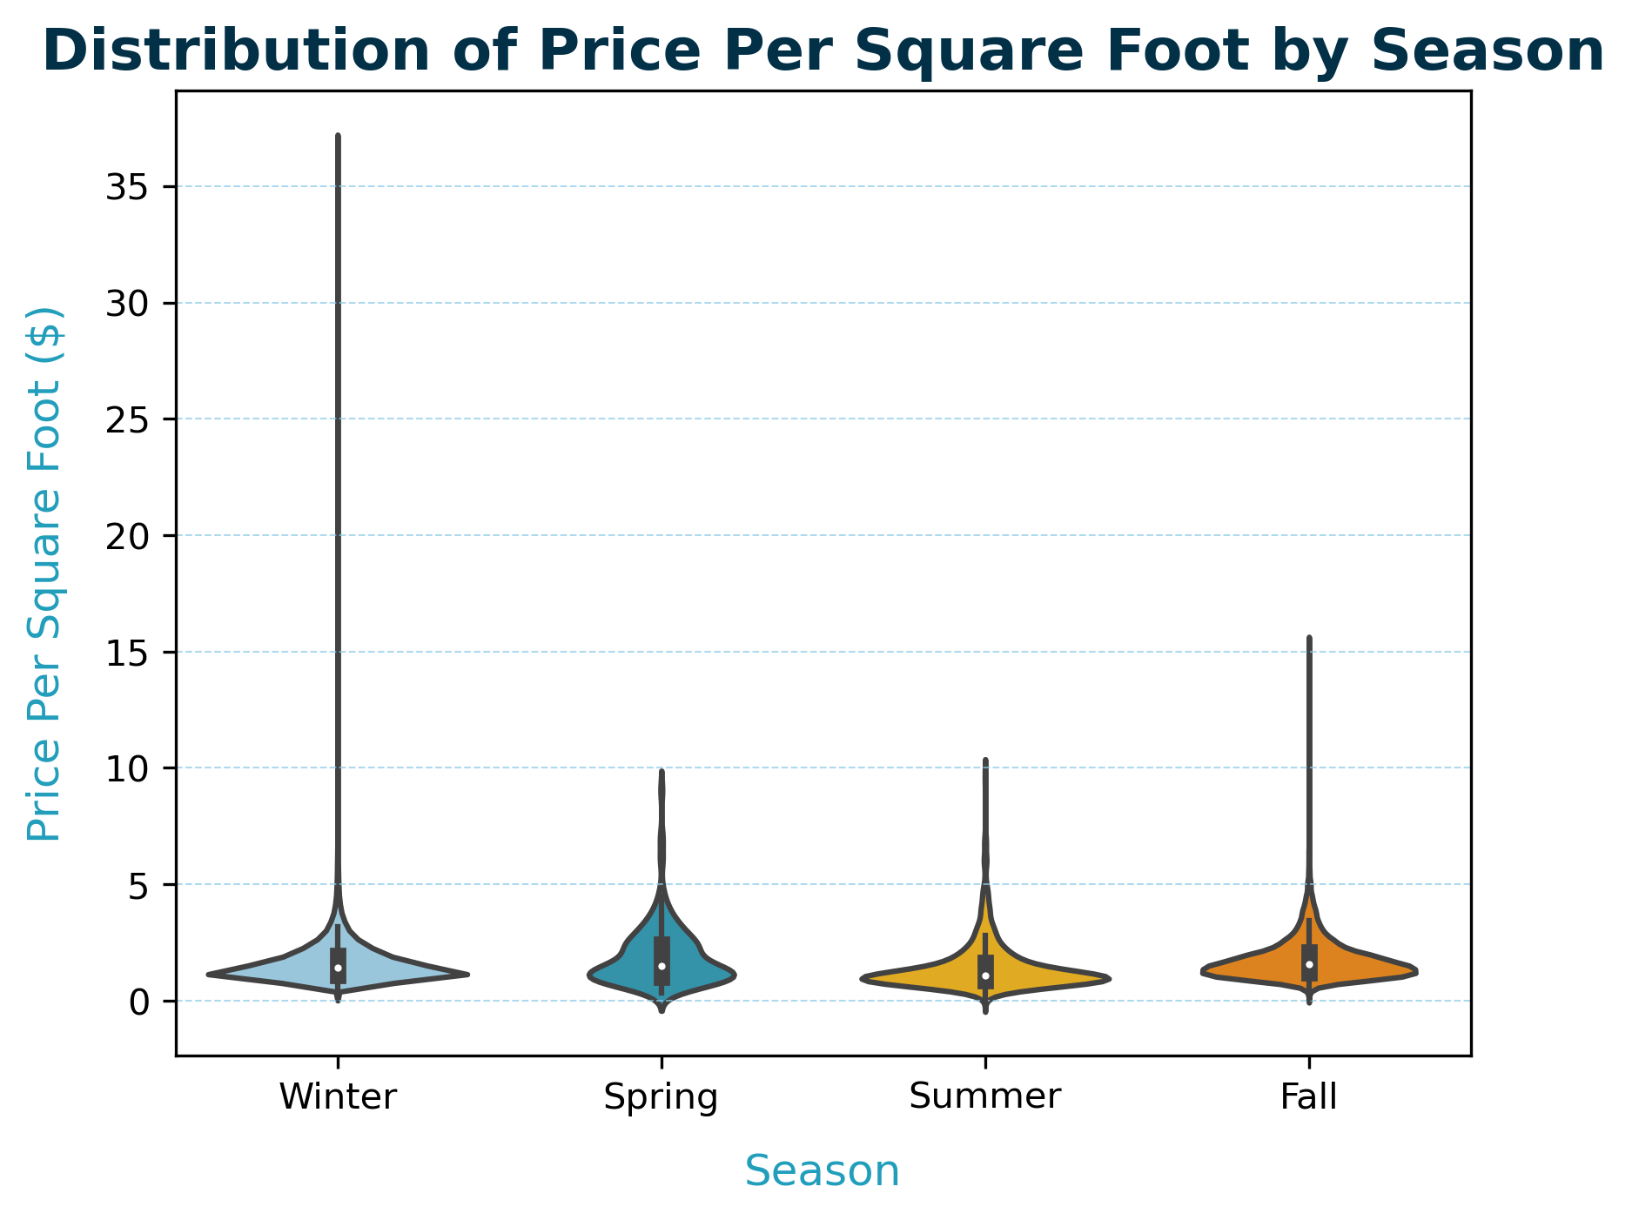
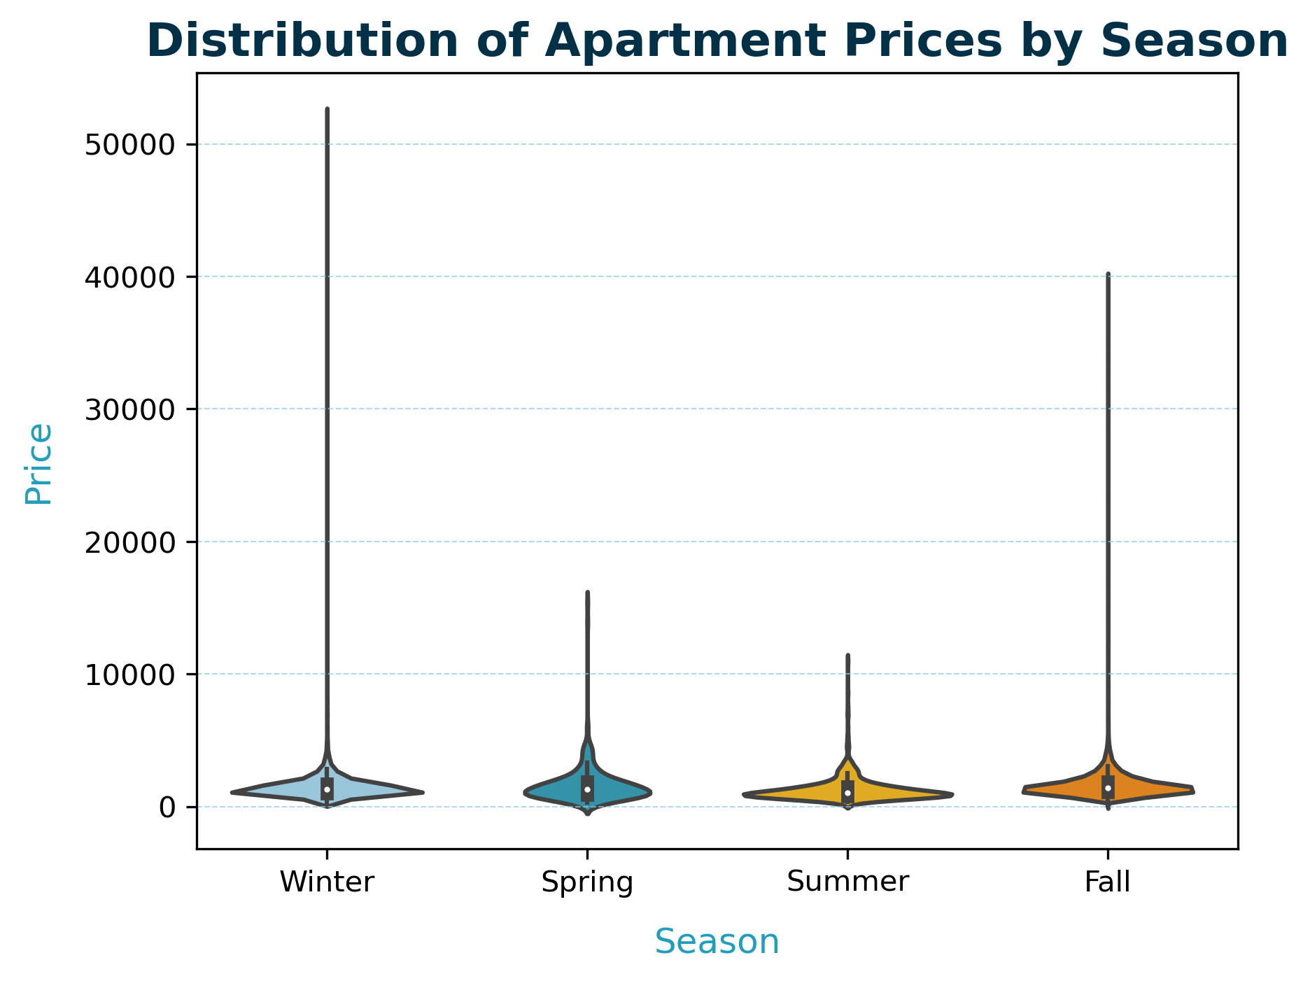
Seasonal Distribution: Price per Square Foot vs Rental Price
Key Insights
?
?
Notes:
The distributions are skewed, with a large number of lower-priced apartments and a few extremely high-priced outliers across all seasons. Median prices (centered white dots) are fairly consistent across seasons, aligning with the bar plot insights showing similar average prices. Spring and Summer have the tightest price ranges, indicating more uniform pricing for units during these seasons. Extreme outliers are present across all seasons but are more pronounced in Winter and Fall. This suggests these seasons may have niche markets for ultra-luxury properties.

Slide 9
Question 2:
How do apartment prices vary between states and cities?

Slide 10
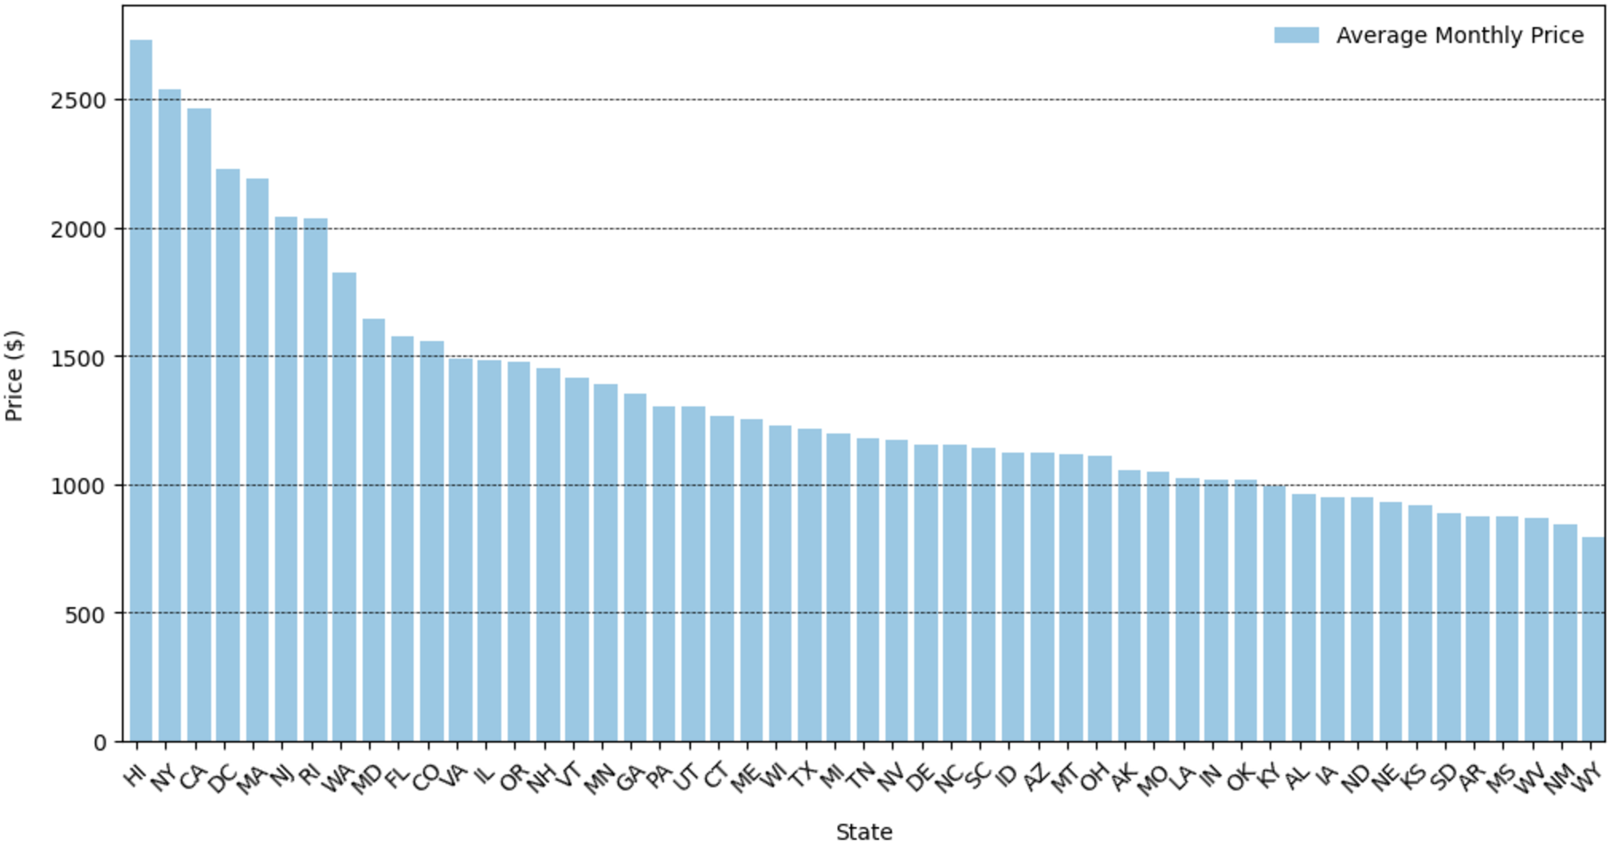
What are the average prices in each state?
Most expensive: Hawaii, New York, California
Least expensive: Wyoming, New Mexico, West Virginia

Slide 11
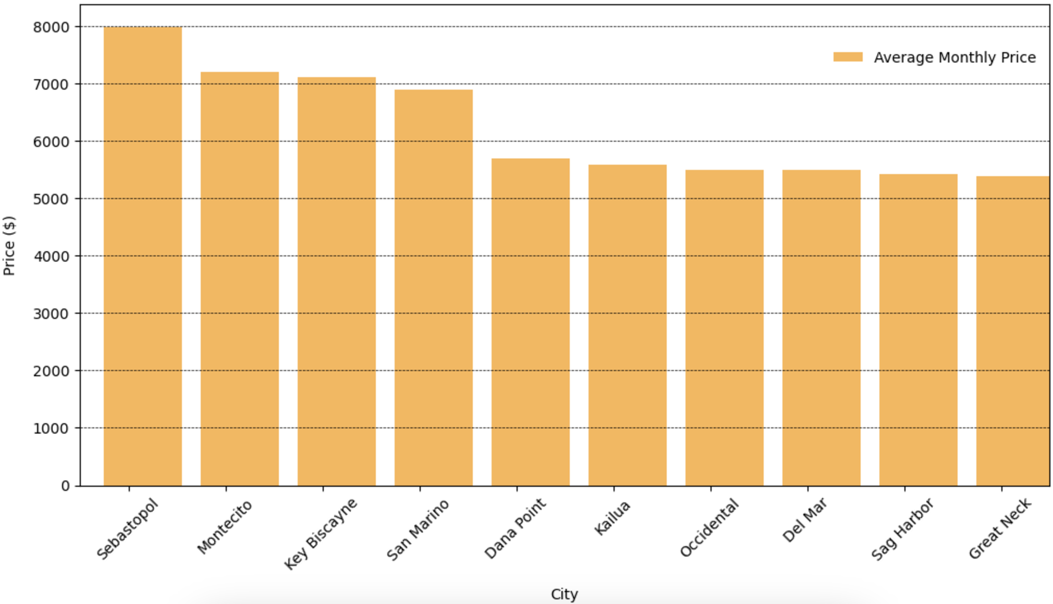
What are the top 10 most expensive cities?
Most expensive: Sebastopol (California), Montecito (California), Key Biscayne (Florida)

Slide 12
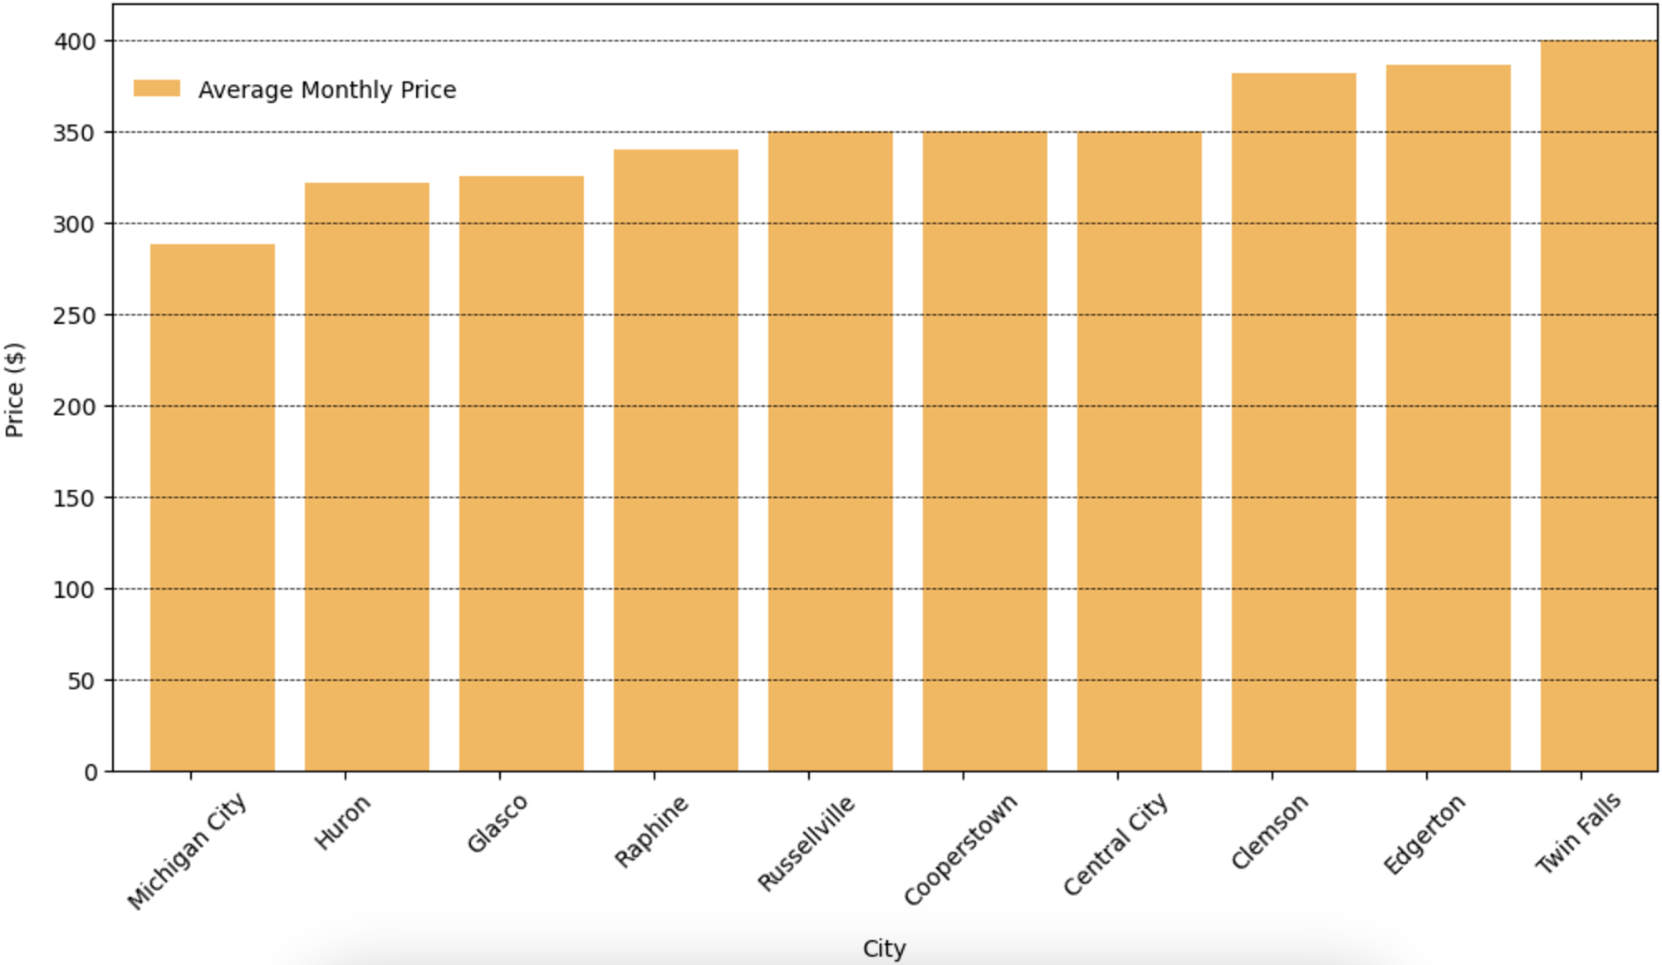
What are the top 10 least expensive cities?
Least expensive: Michigan City (Michigan), Huron (Ohio), Key Biscayne (Kansas)

Slide 13
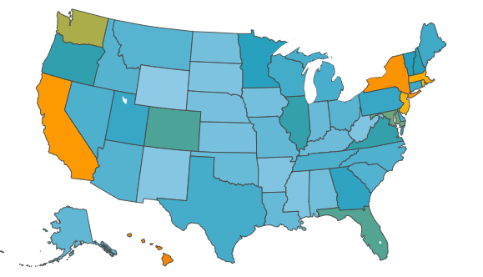

Average Apartment Prices by State in the U.S.

Slide 14
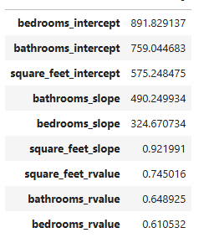
Question 3: What is more valuable to renters—having more bedrooms and bathrooms or having more square footage?
regression_df.dropna().mean(numeric_only=True).sort_values(ascending=False)
Dataset:
Source: Cleaned apartment pricing dataset (clean_data.csv).
Key Columns:
Independent variables: Price, bathrooms, bedrooms, square_feet.
Location identifiers: cityname, state.
Sample Size:
Total rows: 99004
Preprocessing:
Filtered by city and state.
Removed null and inconsistent values.
Performed linear regression for each feature against price.
Slope: Measures rate of price change per unit of the feature.
R-value: Correlation strength between the feature and price.

Slide 15
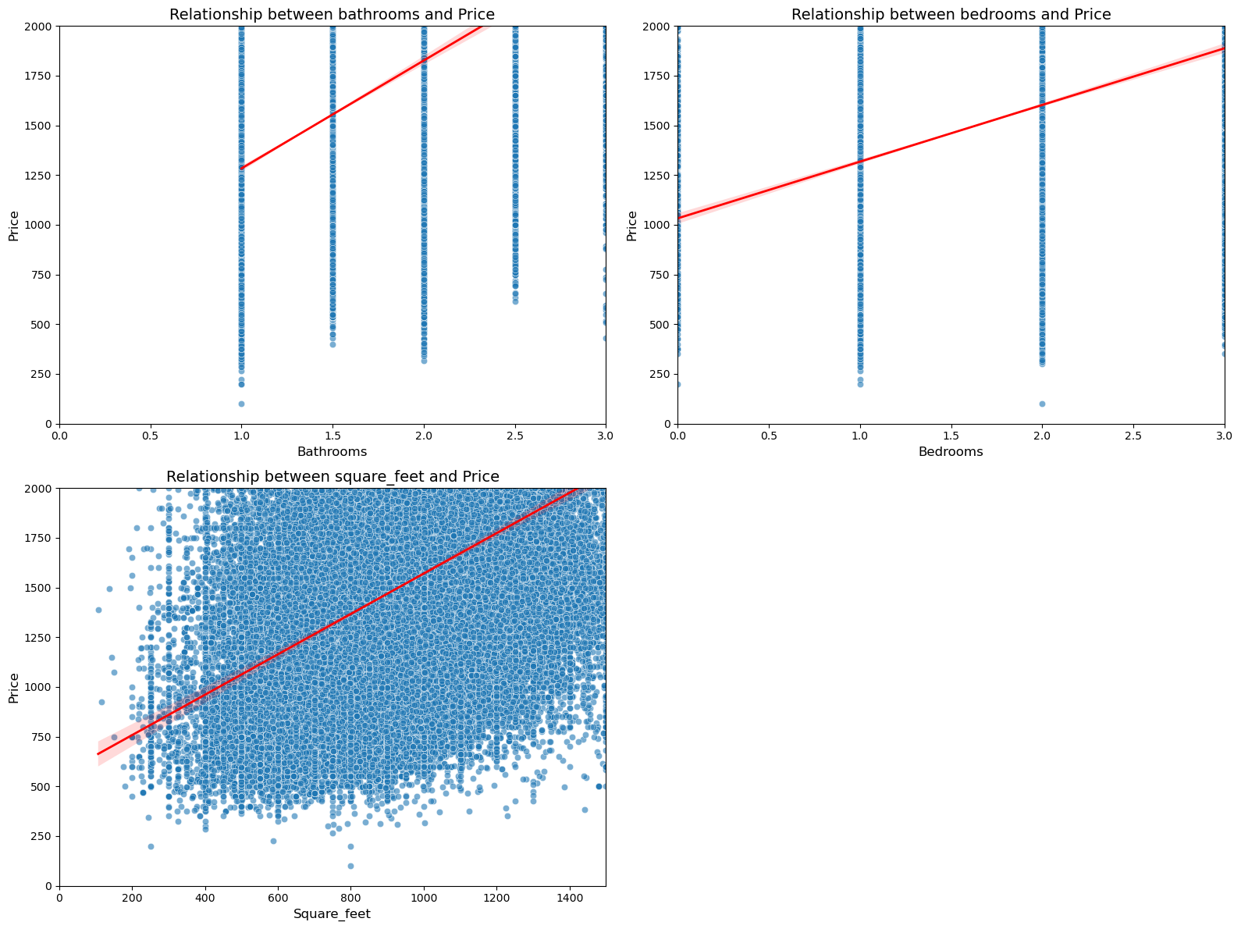
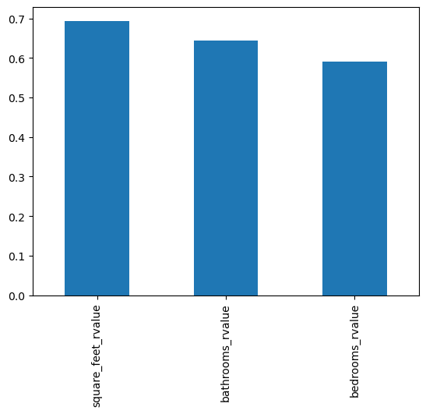
Q 3: Bar / Scatter plots: Relationship between price and "bathrooms", "bedrooms", "square_feet"

Slide 16
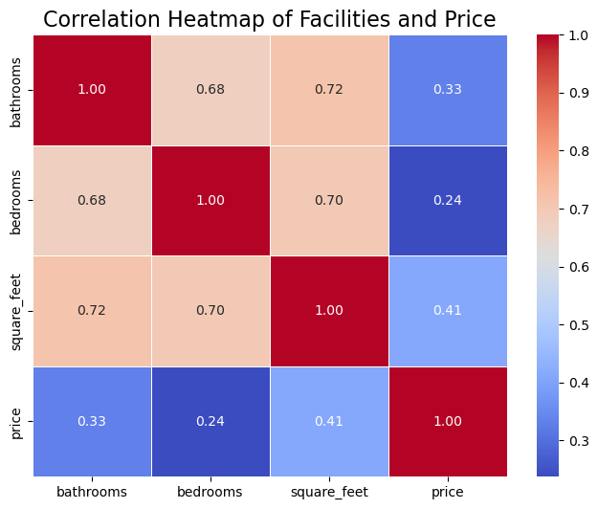
Q 3: Correlation heatmaps for overview
Summary:
Square Feet is the most significant predictor of price.
Variability in bathrooms and bedrooms impact across cities.
Strong correlations highlight critical factors for pricing strategies.
Key Takeaways :
For potential investors: Building more bathrooms is more benefit than more bedrooms.

Slide 17
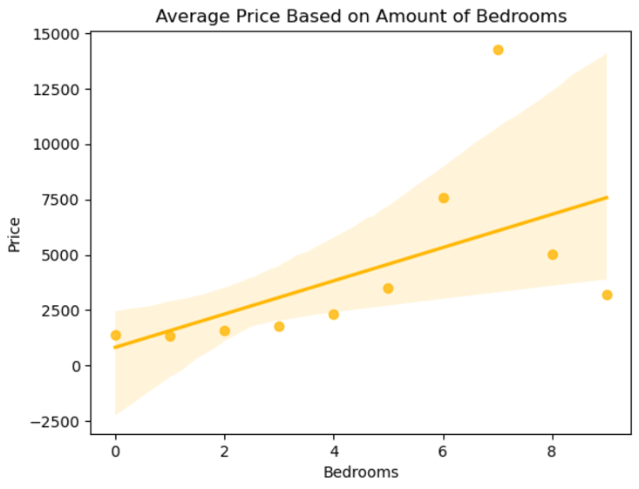
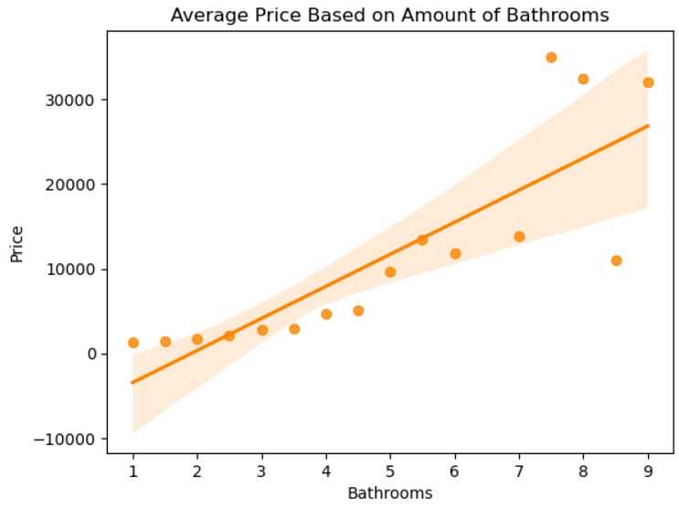
Regressions (what variables have most noticeable regressions?) (what kind of regressions appear in our data?)
Code
Notes:
Pretty obvious positive regression lines. Took an average of variables for each state for simpler data to work with. We can see that while there is a positive regression line, there are also wide confidence intervals. These wide confidence intervals give additional talking points so I won’t just reiterate question 3. Add code info to show where data is coming from

Slide 18
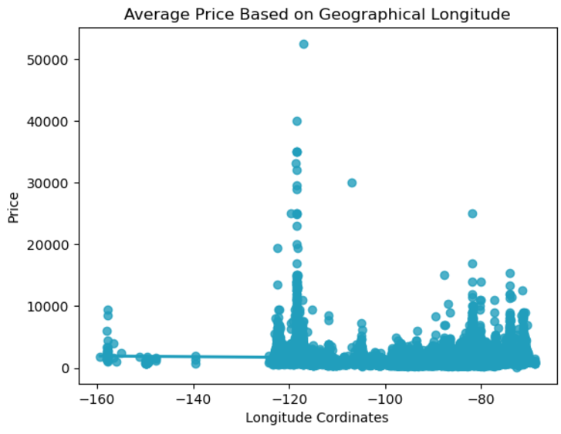
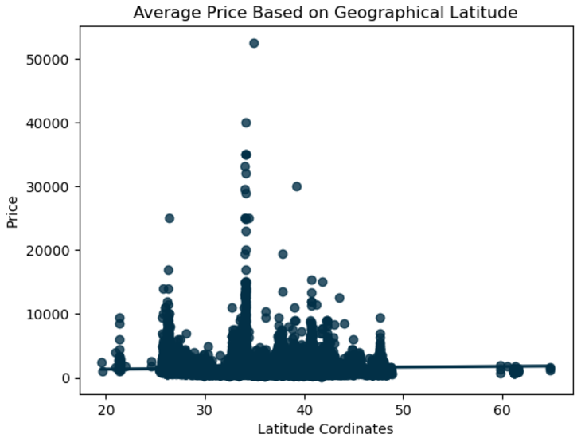
Regressions: Little to no correlation
Notes:
Think about what story is told here even with little info. Going east to west or north to south has little impact on prices. We can see geographical latitude and longitude have no strong connection. This is impacted by outliers, and the fact that some of the most expensive cities are on the west coast, while some of the cheapest are as well.

Slide 19
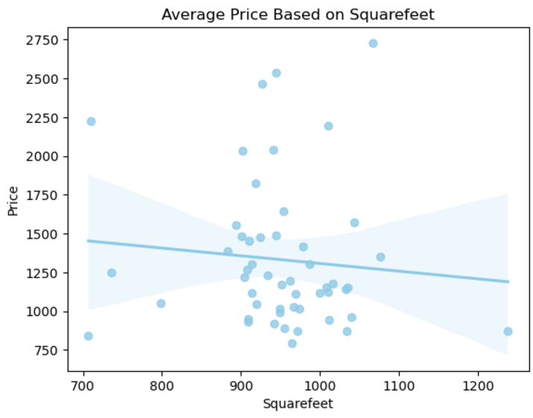
(Interesting regression)
Confidence interval
Notes:
Interesting talking points: what makes this line appear negative? Reminder to myself I took an average so that is what is skewing the data**

Slide 20
Conclusion
Question 1: Fall and spring have higher prices…
Question 2: California, New York, and Hawaii…
Question 3: …

